Slide 1
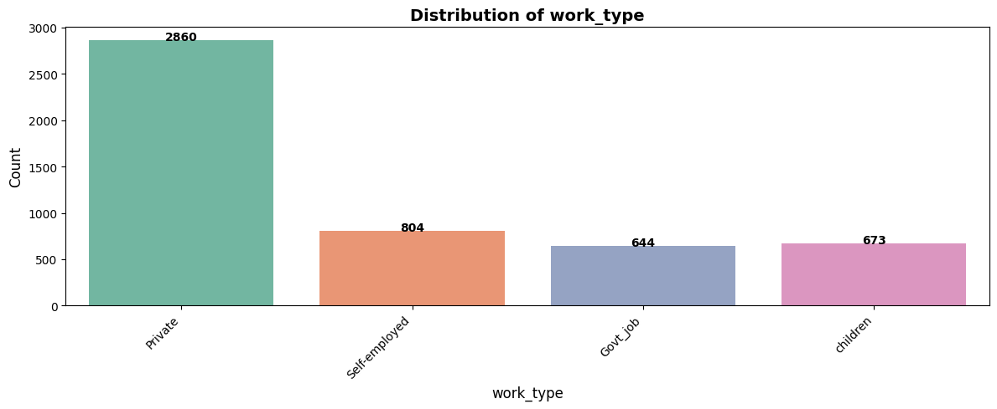
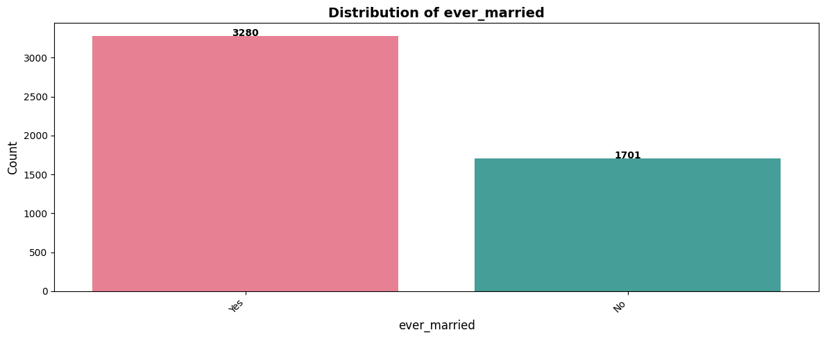
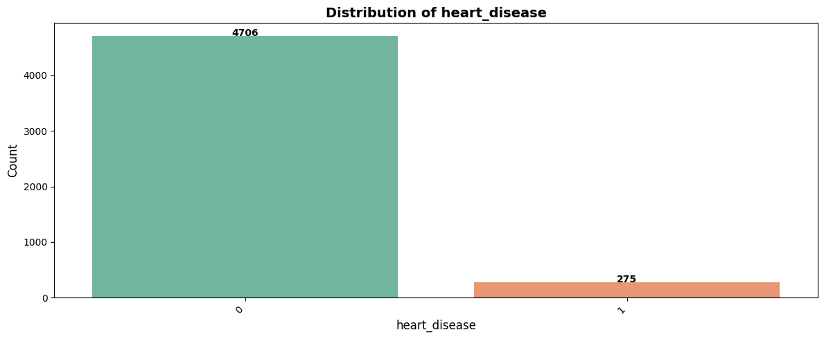
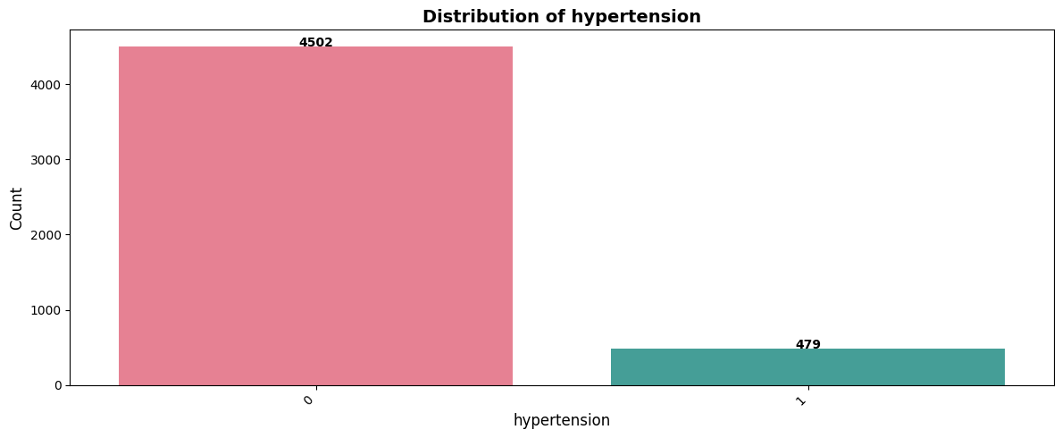
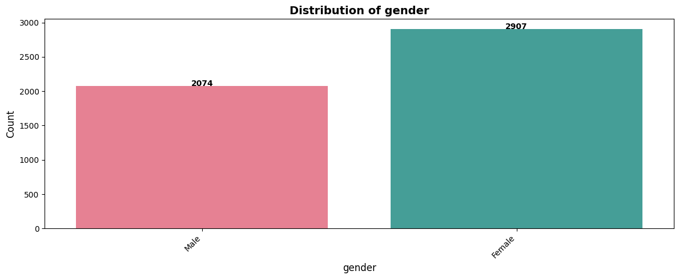
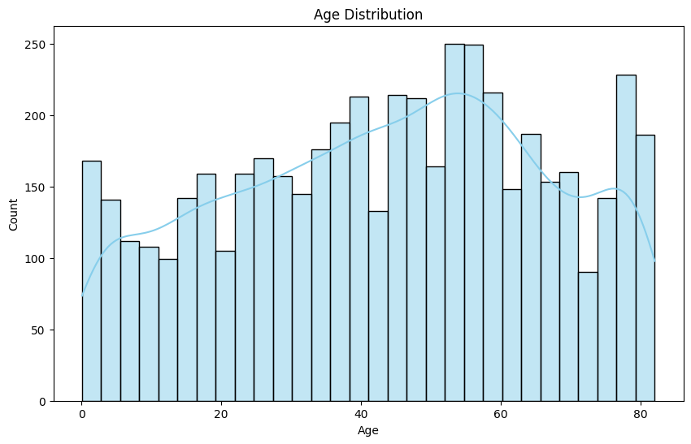
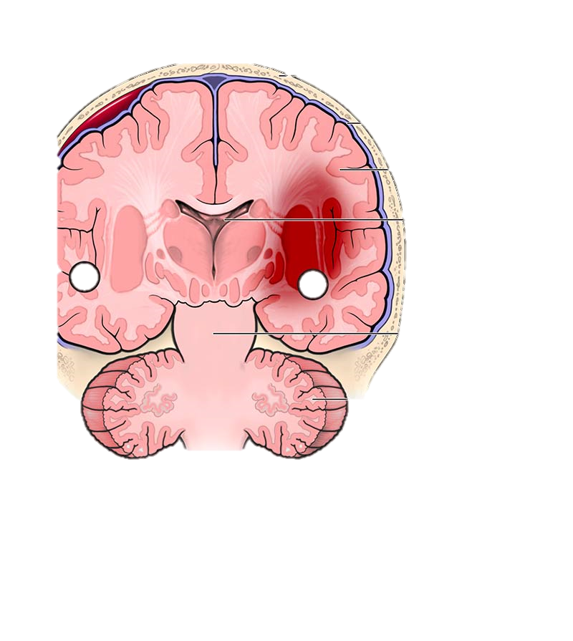
Brain Stroke Analysis
Mohd Wasi

Slide 2
Age:
Older individuals are at a higher risk of stroke due to age-related changes in blood vessels and the heart
Some studies tells that’s modern food habits increase Brian stroke risk early ages
See the trends in the data

Slide 3
Gender:
While both genders can experience stroke, specific risk factors and outcomes may vary between men and women.
men generally have higher rates of stroke due to lifestyle habits and occupational exposures

Slide 4
Hypertension & Heart Disease
Hypertension (high blood pressure) and heart disease are two closely linked conditions that can significantly impact your overall health
High blood pressure is a major risk factor for stroke as it damages blood vessels over time
Conditions like coronary artery disease and atrial fibrillation can increase the risk of stroke.

Slide 5
Ever Married, Work Type, Residence Type
Marital status can influence health behaviors and access to healthcare, which may impact stroke risk
Occupational stress and physical activity levels associated with different work types can contribute to stroke risk
Urban or rural residence can influence exposure to environmental factors and access to healthcare, potentially impacting stroke risk.

Slide 6
Ever Married, Work Type, Residence Type

Slide 7
Smoking Status & BMI
Smoking is a significant risk factor for stroke as it damages blood vessels and increases blood pressure.
Obesity is linked to various health conditions, including heart disease and stroke.

Slide 8

Thank You For Reads
Like || Comment || Share
Mohd Wasi

